Slide 1
Levels of Abstraction

Slide 2
Levels of Abstraction
(Procedural Modeling)
Module’s high-level algorithm is implemented with little concern for the actual hardware
Behavioral
(Continuous Assignment)
Module is implemented by specifying how data flows between registers.
Data Flow
Gate-Level
(Structural Modeling)
Module is implemented in terms of concrete logic gates and their interconnections.

Slide 3
Data Flow Modeling
Most common operators:

Slide 4
Data Flow Modeling
assign x = 3’b010 + 3’b100; // x=3’b110
assign x = 3’b010 && 3’b100; // x=(0+1+0)&(1+0+0)=1’b1
assign x = 3’b010 & 3’b100; // x=3’b000
assign x = !(3'b101) // x=~(1+0+1)=1’b0
assign x= ~(3'b101) // x=3’b010
assign x = 3’b111>> 2; // x=3’b001
assign x = 3’b111<< 2; // x=3’b100
assign y = x >> 2; // shift x to right by 2 bits

Slide 5
Data Flow Modeling
9. assign a= |(3’b101); // a=1|0|1=1: Reduction OR
assign a={2{3’b110}}; // replication: a=6’b110110;
11. assign {cout , sum} = a + b + cin; // concatenation
assign b = 3’b101, c =3’b 111;
assign a = {b, c} // a = 101111
12. assign y = s ? b : a // 2×1 MUX
if s = 1 then y=b otherwise y = a

Slide 6
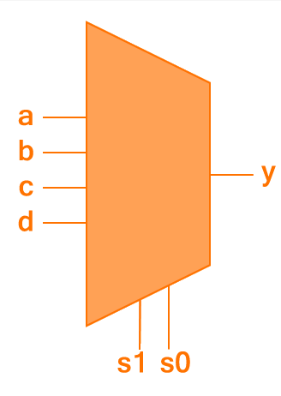
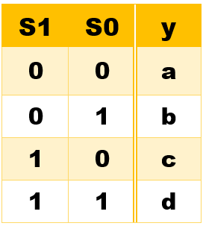
Data Flow Modeling
13. assign y = s1 ? ( s0 ? d : c ) : ( s0 ? b : a ); // 4×1 MUX

Slide 7
Gate-Level Modeling
In gate level modeling a circuit can be defined by use of primitive logic gates.
These gates are predefined in Verilog library.
The basic gates and their syntax is as follows:
and(output, inputs);
or(output, inputs);
not(outputs, input);
buf(outputs, input);
xor(output, inputs);
nor(output, inputs);
nand(output, inputs);
xnor(output, inputs);

Slide 8
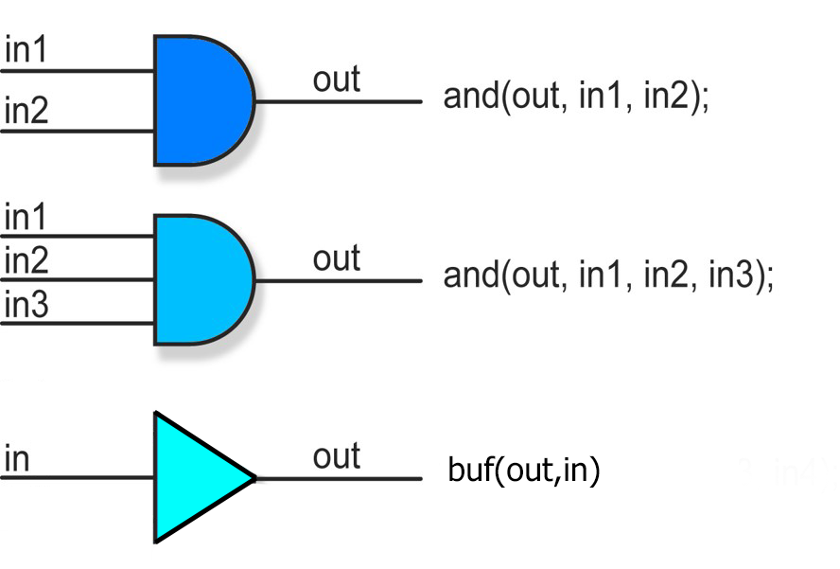
Gate-Level Modeling
In order to label each gate the following syntax can be used:
not my_gate(aBar, a);

Slide 9
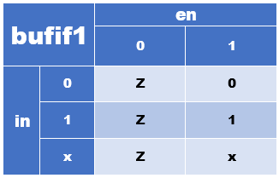
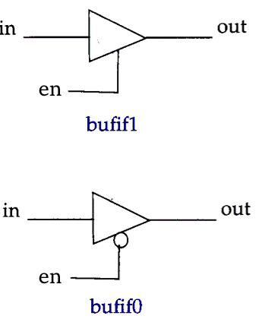
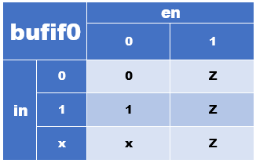
Gate-Level Modeling (Tristate Buffers)
bufif1 gate1(out, in, en);
bufif1 gate2(out, in, en);

Slide 10
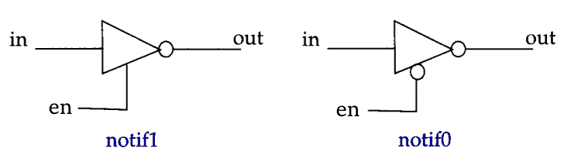
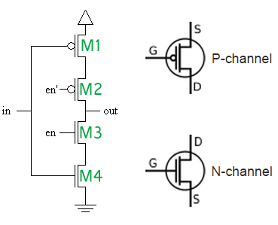
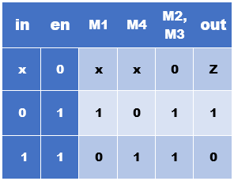
Gate-Level Modeling (Tristate Buffers)
NMOS conducts when its gate voltage is ‘1’ and PMOS conducts when its gate voltage is ‘0’. So the MOSFETS can be modeled as switches. In this table ‘0’ for MOSFETs implies an open switch, whereas ‘1’ implies a closed switch.

Slide 11
Module Instantiation
Module instantiation is a process of connecting one module to another. A similar process in C language is calling a function.
For example in a test bench or stimulus the top level design has to be instantiated

Slide 12
Testing Block (Stimulus)
In order to test your circuit a test bench code is to be written which is commonly called Stimulus.
The design block has to be instantiated.
It displays the output of the design based on the inputs.

Slide 13

Example
2- Input AND Gate
The Design and Stimulus blocks will be as follows:

Slide 14
Design Block
1) Gate-Level Modeling
module practice (y, a, b); // module definition
input a, b; // by default it takes 1 bit input
output y; // single-bit wire output
and gate_1(y, a, b);
endmodule

Slide 15
Design Block
2) Data Flow Modeling
module practice (y, a, b); // module definition
input a, b; // by default it takes 1 bit input
output y; // single-bit wire output
assign y = a & b; // continuous assignment
endmodule

Slide 16
Stimulus Block (Optional)
module stimulus;
reg a, b;
wire y;
//Instantiate the practice module
practice p0(y, a, b);
initial
begin
a=0; b=0;
#5 a=1; b=1;
#5 a=0; b=1;
#5 a=1; b=0;
#5 a=1; b=1;
#5 $stop; // stop the simulation
#5 $finish; // terminate the simulation
end
initial
begin
$display("|%b| and |%b| = ", a, b);
$monitor ($time, "|%b |" , y);
end
//initial
//$vw_dumpvars; // display the simulation in the form of timing diagram
endmodule

